Slide 1
Weaving Together Requirements and Architectures
Bashar Nuseibeh, The Open University
IEEE Computer
Volume 34 Issue 3, March 2001
Presented by George Edwards

Slide 2
Key Contributions of the Paper
Describes an emerging (in 2001) approach to requirements and architecture development
Explains the relationship of the approach to other important trends in software engineering
Component-based development
Design patterns and architectural styles
Agile development and Extreme Programming (XP)
Outlines open questions and research areas

Slide 3
Problem (1/3)
Developers often choose either requirements or architectures as a starting point
Artificially frozen requirements
Constrained architecture
Separation of requirements and design is difficult
Requirements influence and constrain architecture, and vice versa
Artificial ordering compels focus on one aspect at a time
Promising solution: spiral development
Previously proposed development approach
Incremental, iterative development process

Slide 4
Problem (2/3)
Rigid requirements limit available architecture and design choices
For example:
Requirement | Constraints
Run on Android OS | Written in Java or C++
Import data from QuickBooks | Adapters for numerous versions of QB
Prevent unauthorized access | Include authentication capability

Slide 5
Problem (3/3)
A fixed architecture limits the problems that can be addressed
For example:
Architectural Decision | Constraints
Web-based application | Requires clients to have an internet connection
Document-oriented database | JOIN queries will be very slow
Adapt and enhance an open-source component | Developed software may need to be made open-source

Slide 6
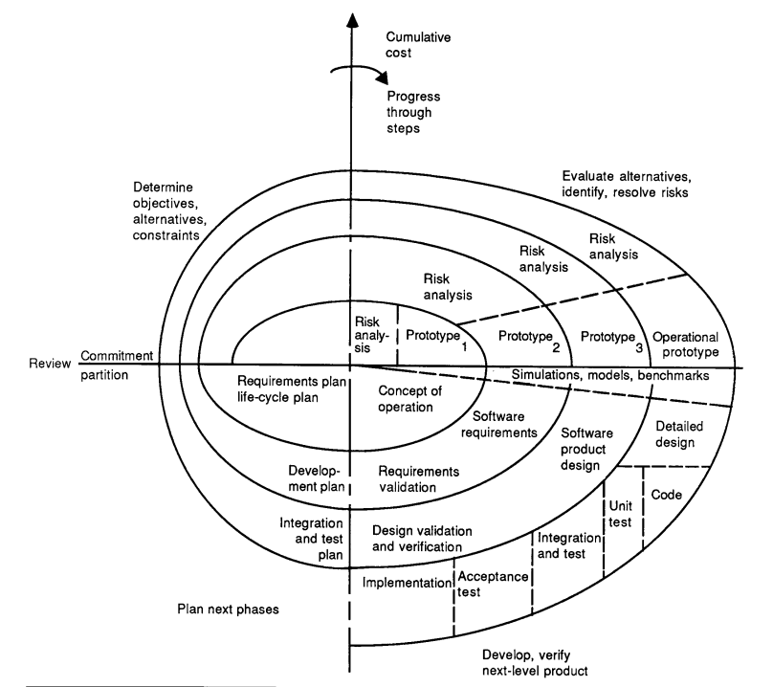
Background: Spiral Development Model

Slide 7
Proposed Solution
Authors propose an adaptation of the spiral model
Called the “Twin Peaks” model
Equal status given to requirements and architecture
Develops requirements and architecture concurrently
Separates problem specification from solution specification
Produces progressively more detailed requirements and design specifications

Slide 8
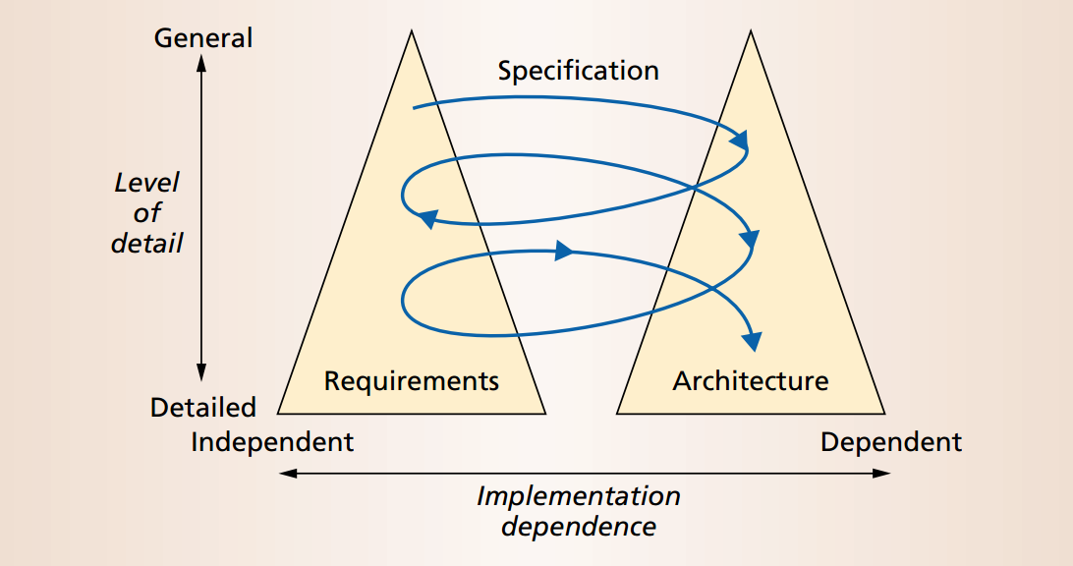
Proposed Approach

Slide 9
Building Modular Software
Software Design Pattern: a general, reusable solution to a commonly occurring problem within a given context
Architectural Style: a named collection of architectural design decisions that are
applicable in a given development context
constrain architectural design decisions that are specific to a particular system within that context
elicit beneficial qualities in each resulting system
Problem Frame: a template characterizing a class of simple problems for which a reliable solution method is known

Slide 10
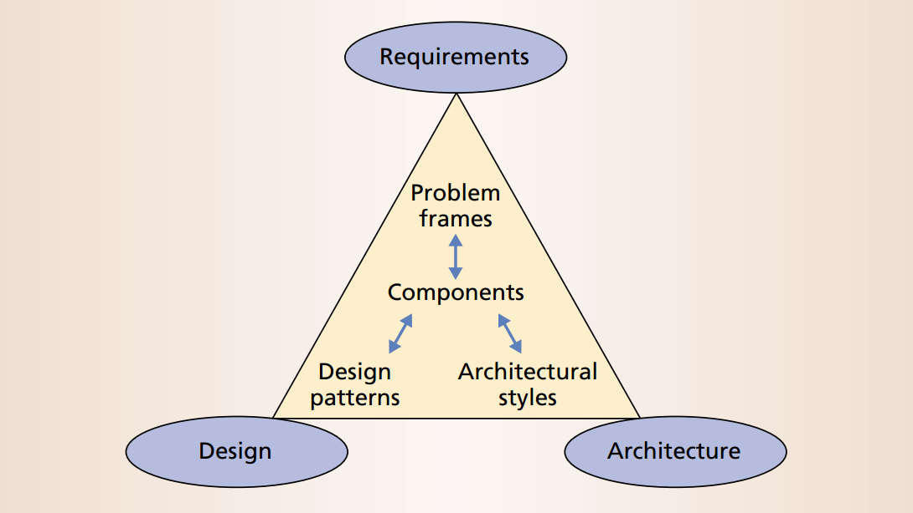
Component-based Development with Twin Peaks

Slide 11
Requirements Management Concerns (1/3)
I’ll Know It When I See It (IKIWISI)
Requirements emerge after users view prototypes and provide feedback
Solution: start design and implementation earlier than usual
Twin Peaks allows the user to
explore the solution space early

Slide 12
Requirements Management Concerns (2/3)
Off-the-shelf software
Requires selecting requirements from existing software packages
Solution: consider reuse at an earlier stage of requirements specification
Twin Peaks allows developers to
match architectures with available products

Slide 13
Requirements Management Concerns (3/3)
Rapid change
Managing change is a fundamental problem in software development and project management
Solution: perform development tasks more quickly
Twin Peaks promotes fine-grained development, accommodating changes as they occur

Slide 14
Twin Peaks and Extreme Programming
Both Twin Peaks and Extreme Programming (XP) emphasize early and iterative exploration of implementation
Twin Peaks and XP are complementary
Twin Peaks focuses on front-end activities
XP focuses on writing code
Twin Peaks helps to address challenges of scale in XP
Modularity
Iteration

Slide 15
Conclusions
In the Twin Peaks model, REs and architects work concurrently and iteratively
Better understanding of problems through consideration of architectural constraints
Optimal architectures through consideration of all design alternatives
Twin Peaks:
Addresses Boehm’s three management concerns
Promotes component-based development
Complements Agile development

Slide 16
Strengths of the Paper
Simple, intuitive concept
Addresses emerging challenges in requirements and architecture
Builds on/complements the existing state-of-the-art (as of 2001)
Spiral model
XP and Agile development
Practical value is clear

Slide 17
Weaknesses of the Paper
Little guidance on how to implement the approach
No specific evidence that it works
No discussion of drawbacks, limitations, or tradeoffs imposed

Slide 18
Open Questions and Future Research
Can the value/utility of the approach be measured?
Is there tool support available?
Has Twin Peaks been widely adopted since the early 2000’s?

Slide 19
What Made the Presentation Good (or Bad)?
Preparation
Practice your talk
Time your practice runs
Content
Outline
Contributions
Problem/Background
Solution
Evaluation (if any)
Conclusions
Critique
Open questions
Provide enough information for the audience to understand the solution, but not additional detail
Clearly define terms before using them
Critique focused mainly on the ideas in the paper

Slide 20
What Made the Presentation Good (or Bad)?
Speaking
Don’t memorize a text or read off the slides
Use simple examples
Engage the audience with questions
Slides
Use pictures, tables, etc.
Just enough text for the audience to follow along
Some, but limited, animation
Callouts and text highlights
Numbers in slide title for related topics

